Slide 1


High Performance Computing
Dr. Amit Barve,
Associate Professor and Head of the Department,
CSE department, PIET, PU

Slide 2
Motivating Parallelism
The role of parallelism in accelerating computing speeds has been recognized for several decades. Developing parallel hardware and software has traditionally been time and effort intensive.
If one is to view this in the context of rapidly improving uniprocessor speeds, one is tempted to question the need for parallel computing.
There are some unmistakable trends in hardware design, which indicate that uniprocessor (or implicitly parallel) architectures may not be able to sustain the rate of realizable performance increments in the future.
This is the result of a number of fundamental physical and computational limitations.
The emergence of standardized parallel programming environments, libraries, and hardware have significantly reduced time to (parallel) solution.

Slide 3
  The vector column_sum is small and easily fits into the cache
  The matrix b is accessed in a column order.
  The strided access results in very poor performance.

Slide 4
Example of memory Bandwidth
Consider the following code fragment:
for (i = 0; i < 1000; i++)
column_sum[i] = 0.0;
for (j = 0; j < 1000; j++)
column_sum[i] += b[j][i];
The code fragment sums columns of the matrix b into a vector column_sum.

Slide 5
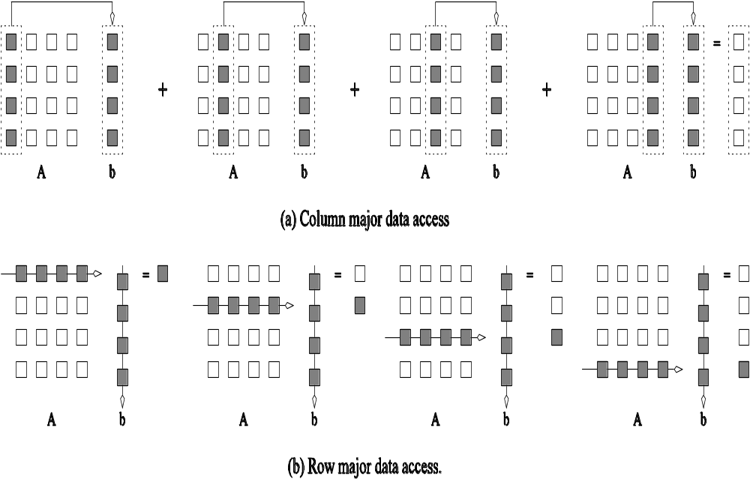
Multiplying a matrix with a vector: (a) multiplying column-by-column, keeping a running sum; (b) computing each element of the result as a dot product of a row of the matrix with the vector.

Slide 6
Impact of Memory Bandwidth: Example
_x000b_
We can fix the above code as follows:
for (i = 0; i < 1000; i++)
column_sum[i] = 0.0;
for (j = 0; j < 1000; j++)
for (i = 0; i < 1000; i++)
column_sum[i] += b[j][i];
In this case, the matrix is traversed in a row-order and performance can be expected to be significantly better.

Slide 7
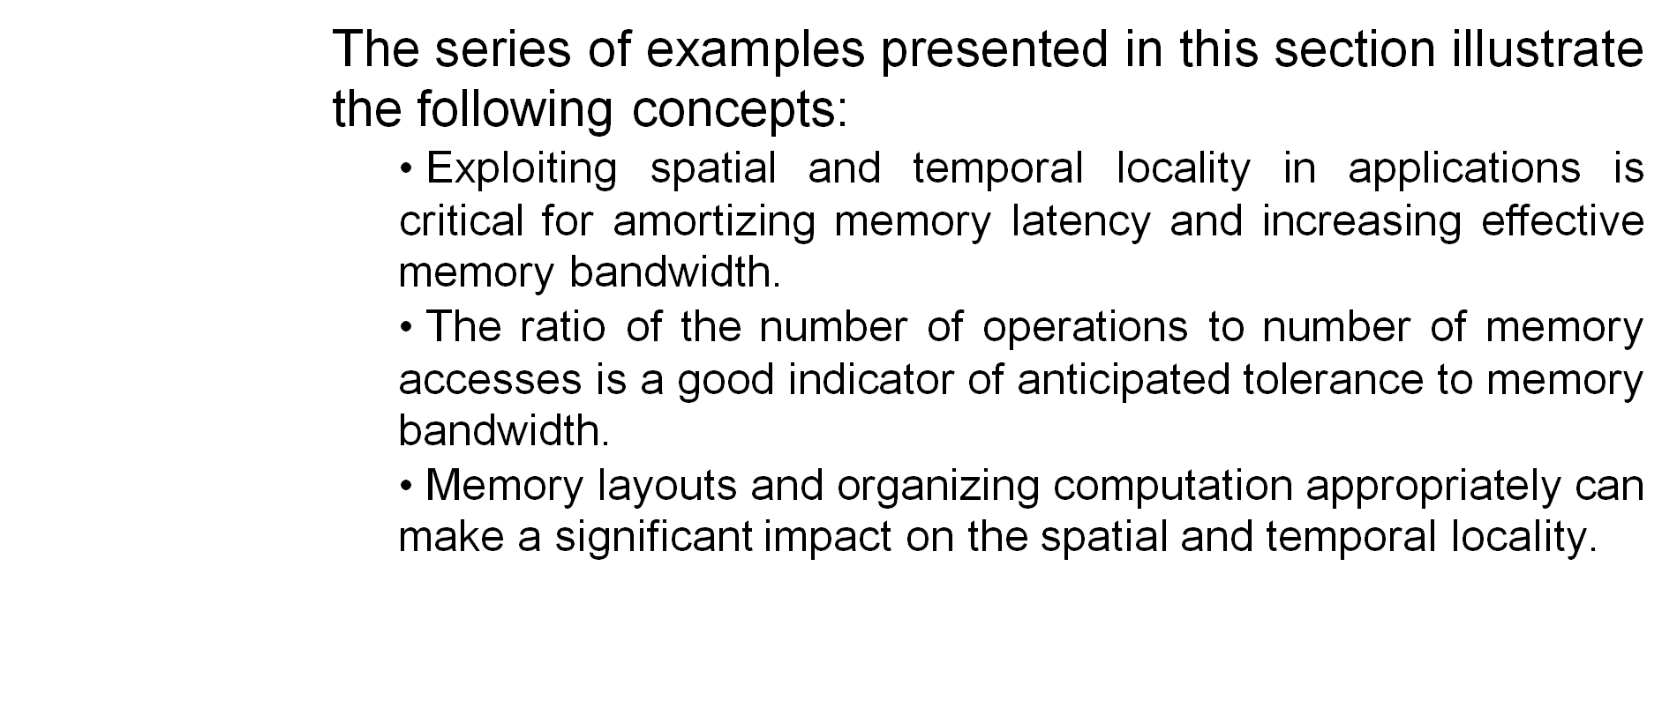
Memory System Performance: Summary

Slide 8
Dichotomy of Parallel
Computing Platforms

Slide 9
Control Structure of Parallel Programs
Processing units in parallel computers either operate under the centralized control of a single control unit or work independently.
If there is a single control unit that dispatches the same instruction to various processors (that work on different data), the model is referred to as single instruction stream, multiple data stream (SIMD).
If each processor has its own control control unit, each processor can execute different instructions on different data items. This model is called multiple instruction stream, multiple data stream (MIMD).

Slide 10
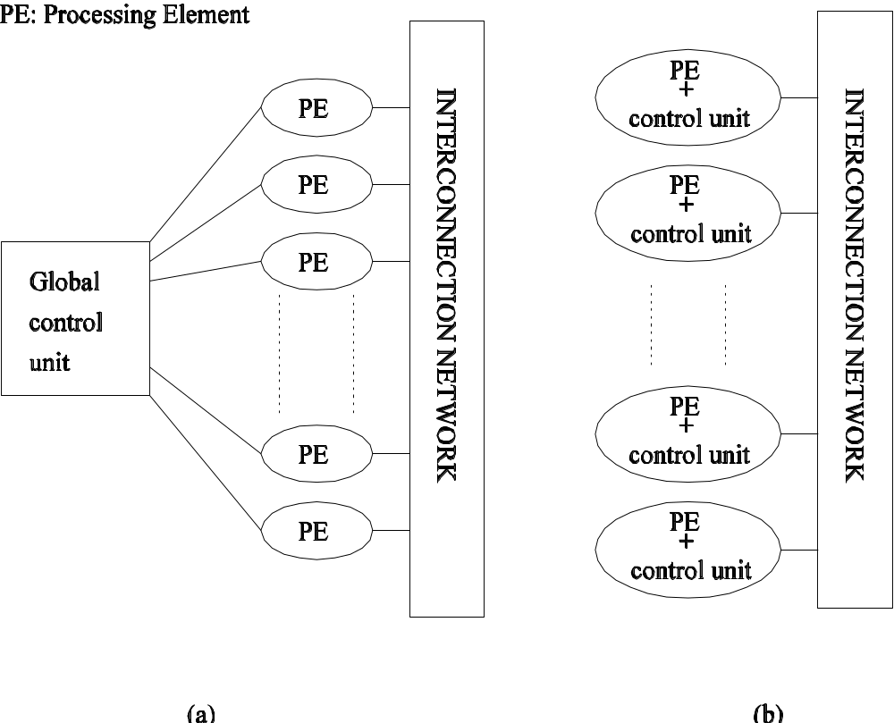
SIMD and MIMD Processors
A typical SIMD architecture (a) and a typical MIMD architecture (b).

Slide 11
SIMD Processors
Some of the earliest parallel computers such as the Illiac IV, MPP, DAP, CM-2, and MasPar MP-1 belonged to this class of machines.
Variants of this concept have found use in co-processing units such as the MMX units in Intel processors and DSP chips such as the Sharc.
SIMD relies on the regular structure of computations (such as those in image processing).
It is often necessary to selectively turn off operations on certain data items. For this reason, most SIMD programming paradigms allow for an ``activity mask'', which determines if a processor should participate in a computation or not.

Slide 12
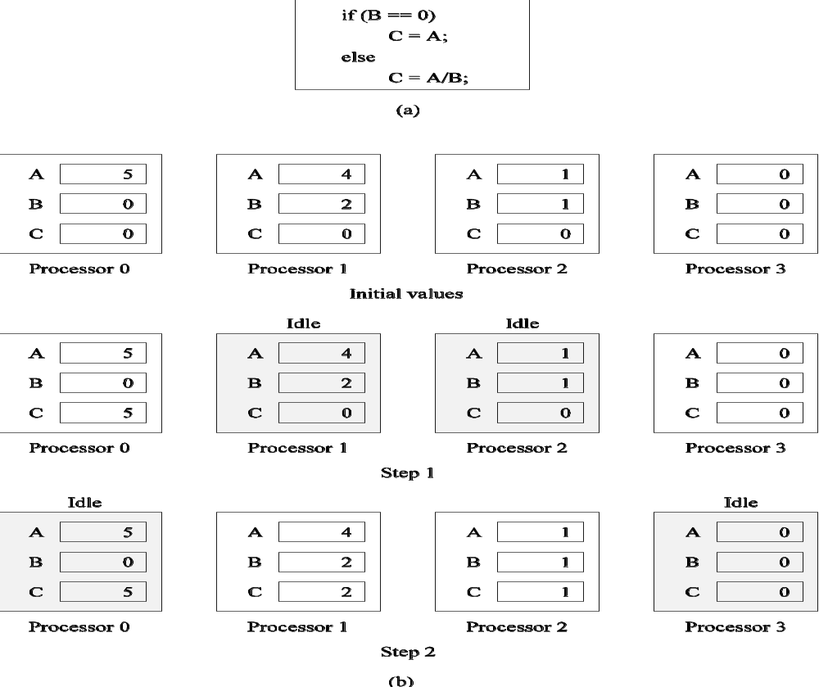
Conditional Execution in SIMD Processors
Executing a conditional statement on an SIMD computer with four processors: (a) the conditional statement; (b) the execution of the statement in two steps.

Slide 13
MIMD Processors
In contrast to SIMD processors, MIMD processors can execute different programs on different processors.
A variant of this, called single program multiple data streams (SPMD) executes the same program on different processors.
It is easy to see that SPMD and MIMD are closely related in terms of programming flexibility and underlying architectural support.
Examples of such platforms include current generation Sun Ultra Servers, SGI Origin Servers, multiprocessor PCs, workstation clusters, and the IBM SP.

Slide 14
SIMD-MIMD Comparison
SIMD computers require less hardware than MIMD computers (single control unit).
However, since SIMD processors ae specially designed, they tend to be expensive and have long design cycles.
Not all applications are naturally suited to SIMD processors.
In contrast, platforms supporting the SPMD paradigm can be built from inexpensive off-the-shelf components with relatively little effort in a short amount of time.

Slide 15
Communication Model of Parallel Platforms
There are two primary forms of data exchange between parallel tasks - accessing a shared data space and exchanging messages.
Platforms that provide a shared data space are called shared-address-space machines or multiprocessors.
Platforms that support messaging are also called message passing platforms or multicomputers.

Slide 16
Shared-Address-Space Platforms
Part (or all) of the memory is accessible to all processors.
Processors interact by modifying data objects stored in this shared-address-space.
If the time taken by a processor to access any memory word in the system global or local is identical, the platform is classified as a uniform memory access (UMA), else, a non-uniform memory access (NUMA) machine.

Slide 17
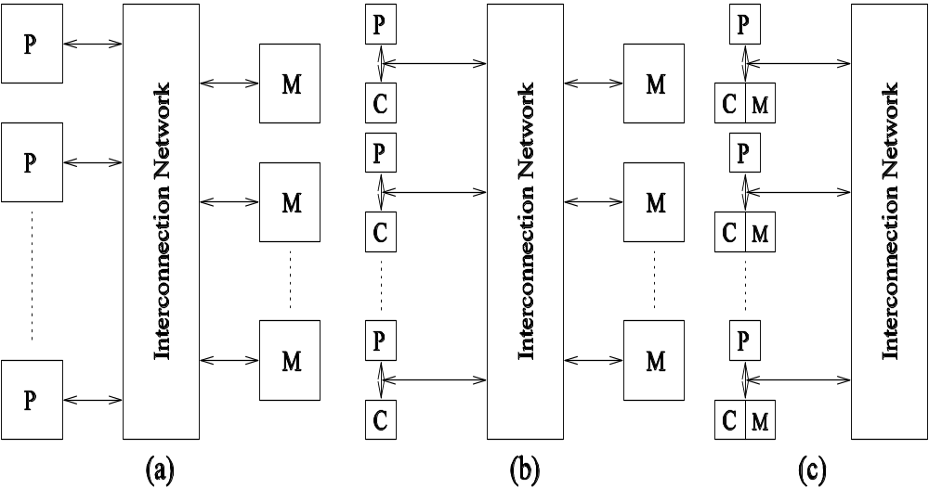
NUMA and UMA Shared-Address-Space Platforms
Typical shared-address-space architectures: (a) Uniform-memory access shared-address-space computer; (b) Uniform-memory-access shared-address-space computer with caches and memories; (c) Non-uniform-memory-access shared-address-space computer with local memory only.

Slide 18
NUMA and UMA Shared-Address-Space Platforms
The distinction between NUMA and UMA platforms is important from the point of view of algorithm design. NUMA machines require locality from underlying algorithms for performance.
Programming these platforms is easier since reads and writes are implicitly visible to other processors.
However, read-write data to shared data must be coordinated (this will be discussed in greater detail when we talk about threads programming).
Caches in such machines require coordinated access to multiple copies. This leads to the cache coherence problem.
A weaker model of these machines provides an address map, but not coordinated access. These models are called non cache coherent shared address space machines.

Slide 19
Shared-Address-Space vs. Shared Memory machines
It is important to note the difference between the terms shared address space and shared memory.
We refer to the former as a programming abstraction and to the latter as a physical machine attribute.
It is possible to provide a shared address space using a physically distributed memory.

Slide 20
Message-Passing Platforms
These platforms comprise of a set of processors and their own (exclusive) memory.
Instances of such a view come naturally from clustered workstations and non-shared-address-space multicomputers.
These platforms are programmed using (variants of) send and receive primitives.
Libraries such as MPI and PVM provide such primitives.

Slide 21
Message Passing vs. Shared Address Space Platforms
Message passing requires little hardware support, other than a network.
Shared address space platforms can easily emulate message passing. The reverse is more difficult to do (in an efficient manner).

Slide 22
Physical Organization
of Parallel Platforms _x000b_

Slide 23
Architecture of an Ideal Parallel Computer
A natural extension of the Random Access Machine (RAM) serial architecture is the Parallel Random Access Machine, or PRAM.
PRAMs consist of p processors and a global memory of unbounded size that is uniformly accessible to all processors.
Processors share a common clock but may execute different instructions in each cycle.

Slide 24
Architecture of an Ideal Parallel Computer
Depending on how simultaneous memory accesses are handled, PRAMs can be divided into four subclasses.
  Exclusive-read, exclusive-write (EREW) PRAM.
  Concurrent-read, exclusive-write (CREW) PRAM.
  Exclusive-read, concurrent-write (ERCW) PRAM.
  Concurrent-read, concurrent-write (CRCW) PRAM.

Slide 25
Architecture of an Ideal Parallel Computer
What does concurrent write mean, anyway?
  Common: write only if all values are identical.
  Arbitrary: write the data from a randomly selected processor.
  Priority: follow a predetermined priority order.
  Sum: Write the sum of all data items.

Slide 26
Physical Complexity of an Ideal Parallel Computer
Processors and memories are connected via switches.
Since these switches must operate in O(1) time at the level of words, for a system of p processors and m words, the switch complexity is O(mp).
Clearly, for meaningful values of p and m, a true PRAM is not realizable.

Slide 27
Interconnection Networks for Parallel computers
Interconnection networks carry data between processors and to memory.
Interconnects are made of switches and links (wires, fiber).
Interconnects are classified as static or dynamic.
Static networks consist of point-to-point communication links among processing nodes and are also referred to as direct networks.
Dynamic networks are built using switches and communication links. Dynamic networks are also referred to as indirect networks.

Slide 28
Interconnection Networks for Parallel computers
Interconnection networks carry data between processors and to memory.
Interconnects are made of switches and links (wires, fiber).
Interconnects are classified as static or dynamic.
Static networks consist of point-to-point communication links among processing nodes and are also referred to as direct networks.
Dynamic networks are built using switches and communication links. Dynamic networks are also referred to as indirect networks.

Slide 30


www.paruluniversity.ac.in

